Slide 1
MSOA Football Game Day Meeting Places
These are approximate areas, but also fairly accurate, ALWAYS check the ARBITER for notes from your Referee.
Times to meet will be posted in ARBITER.
JV, 9th, & MS come partially dressed.
Varsity (all including ECO’s/25sec) will wear appropriate attire and change at the game site.
Always have phone #s for your crew in case of Emergency
ALWAYS plan for and expect traffic delays

Slide 2
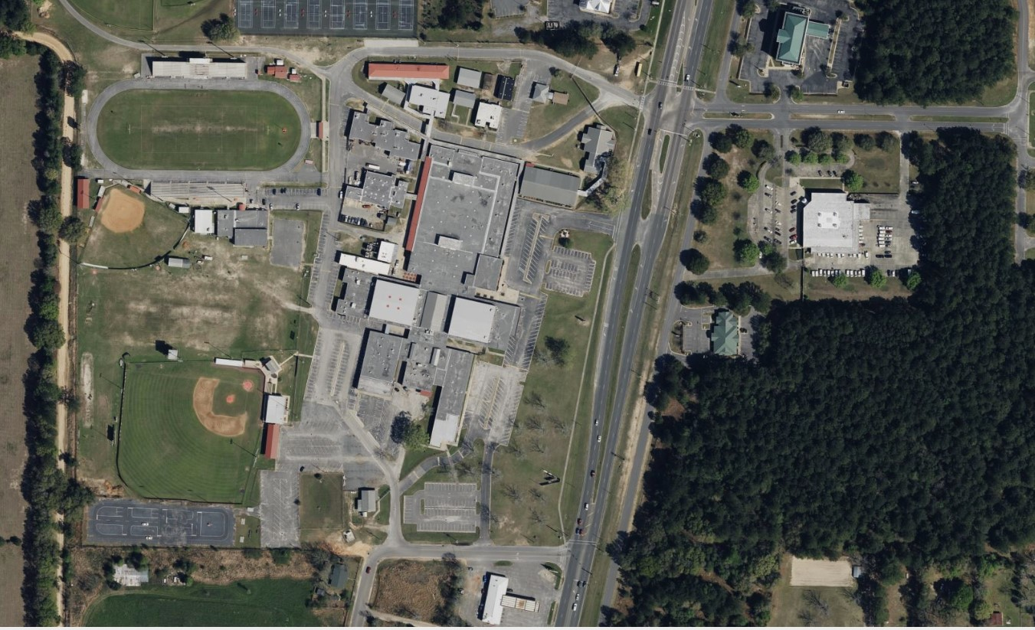
Crestview High School & Davidson MS
Enter here for JV,9th & MS
JV, 9th, & Davidson MS
Meet here
Enter here for varsity
Varsity meets here

Slide 3
Shoal River MS
Go thru gate turn left & park

Slide 4
Niceville High School, Ruckle MS & Lewis MS
JV, 9th, Ruckle MS, Lewis MS meets here
Varsity meets here

Slide 5
Destin MS
Enter here
All games meet here

Slide 6
Meigs MS
Enter here
Meet here

Slide 7
Choctaw High School & Pryor MS
JV, 9th and Pryor MS meet here
Varsity meets here
Enter here

Slide 8
Ft Walton Beach High School & Bruner MS
JV, 9th, MS meet here
Varsity in Portable
ALL enter here

Slide 9
Pace High School
Park here
Meet here
Enter here

Slide 10
Navarre High School
All park as shown & go thru far right gate. Then meet here
All enter here

Slide 11
Gulf Breeze High School
ALL meet here, park in front of Bldg

Slide 12
Milton High School
Park here
Enter here

Slide 13
Tate High School
Enter here
Varsity meet here.

